Slide 1
Intro to Eagle

Slide 2
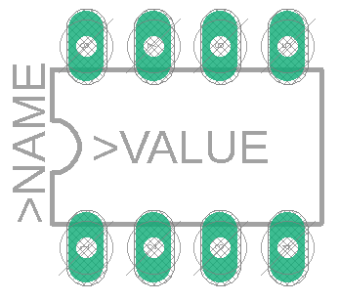
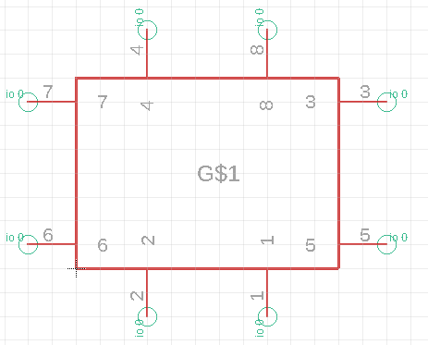
Libraries and Parts
Device
Symbol (pins & labels)
Footprint (dimensions & layout)

Slide 3
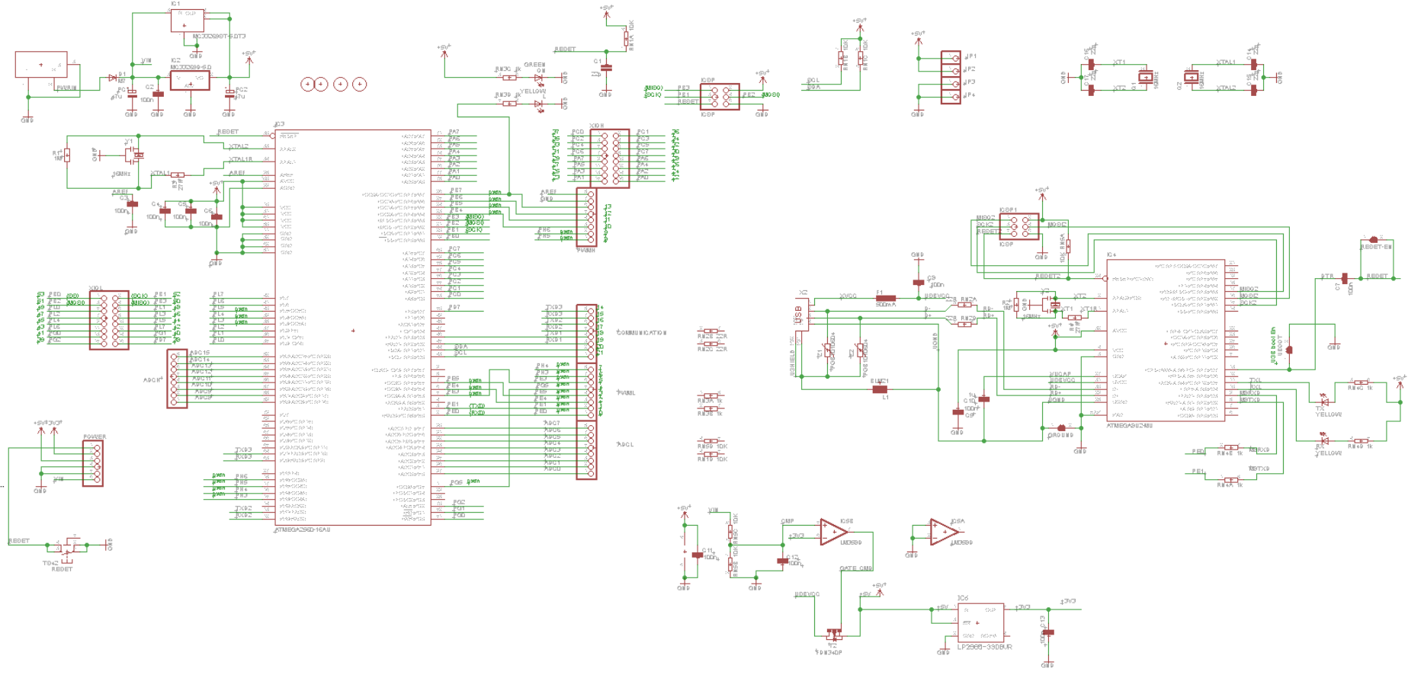
Schematics – Symbolic Diagrams
This is where you define components and values
Color codes
Red = components
Green = nets + buses (define physical connections)
Note - nets don’t need to be continuous. Label and split to improve readability.

Slide 4
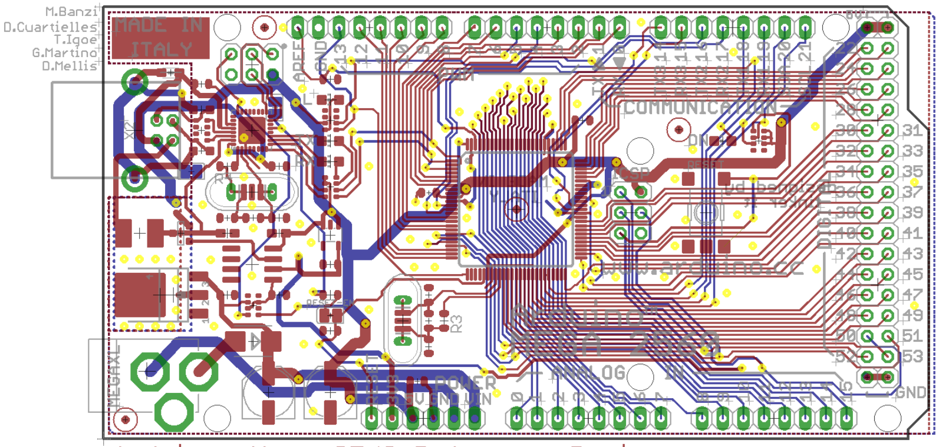
Routing – Designing the Actual Board
This is what the actual PCB will look like
Color codes:
Green = pads (points where component is mounted on board)
Red/Blue = routes (one on each side of the board)
Note that thickness may vary
Yellow = vias (switch sides)
Try to minimize these
IMPORTANT: routes CANNOT cross

Slide 5
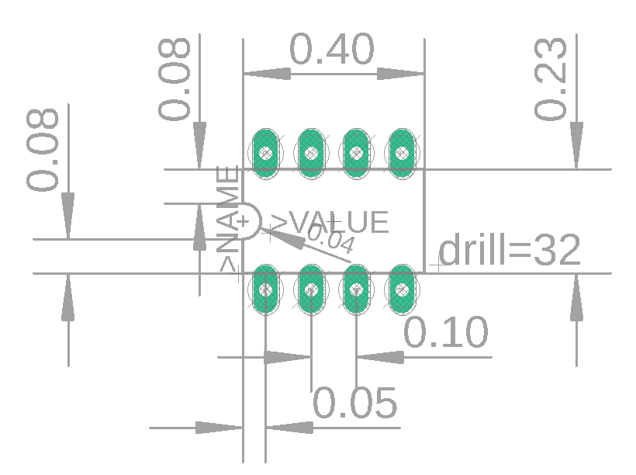
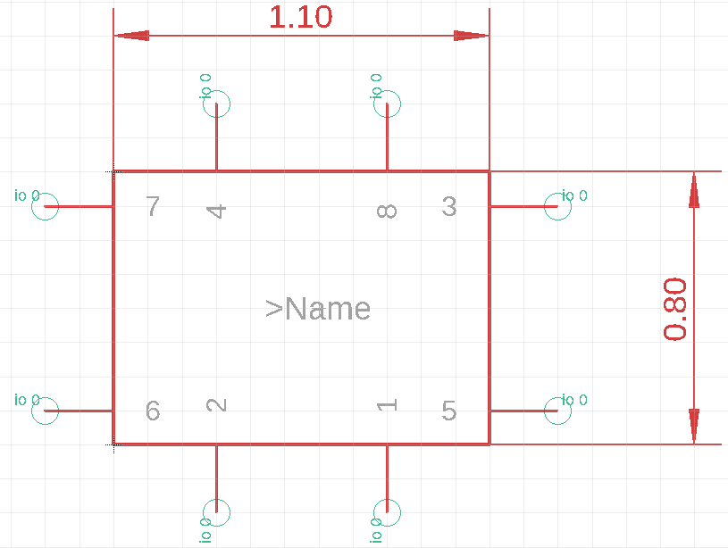
Example Part: 555 Timer

